Slide 1


Slide 2

Social Media Study
Tutorial 1
Scrape, clean, EDA, some data science - Twitter

Slide 3
Hello!
I am Abeer Khan

Slide 4
What is today?

Slide 5
What is today? - background

Slide 6
What is today? - background
Nonprofit organizations Waterloo
Social media presence
Goals
Increase following
Increase engagement
Serve community
…
Multiple meetups

Slide 7
What is today?
Introduce techniques
Scrape social media data
Twitter
Cleaning
Meaningless, emojis, stemming, lemmatization
Text analysis
Sentiment, word frequency, cloud, topic modeling, POS tagging

Slide 8
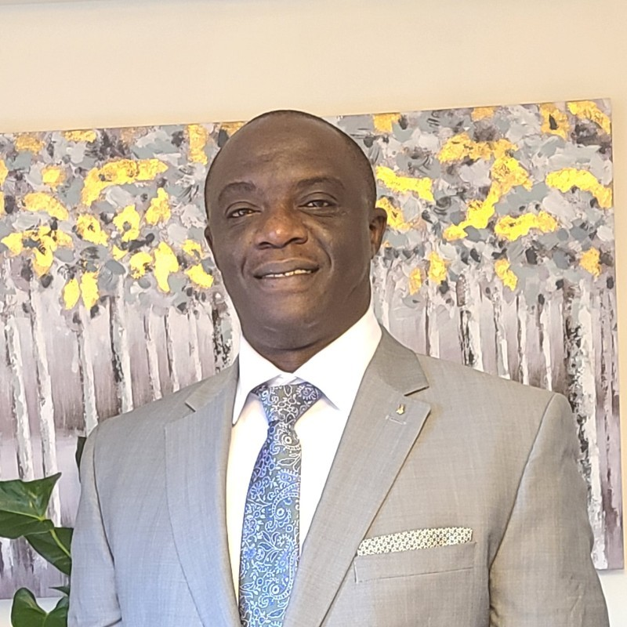
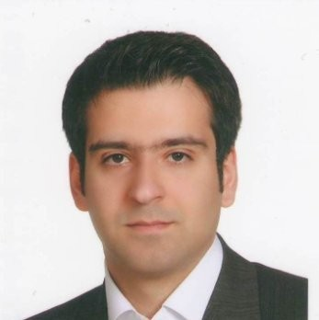
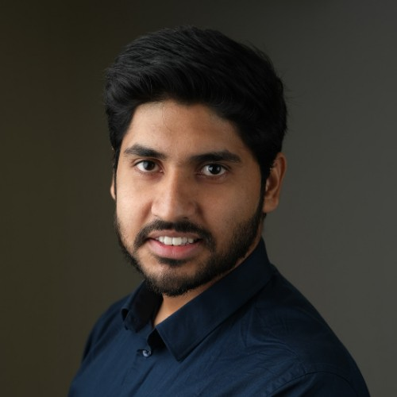
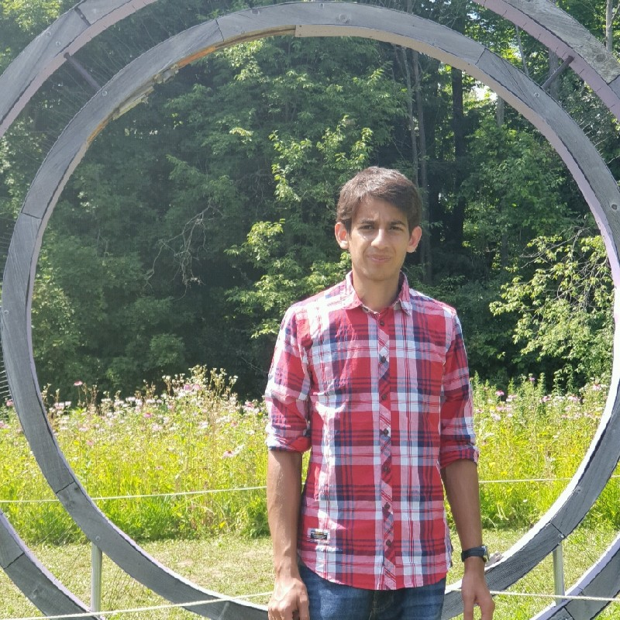
Who are we?
Joseph Mwangoka
PhD | Fraud Detection | Data Analytics | Technology Strategy
https://www.linkedin.com/in/joseph-mwangoka/
Sepehr Sepehri
Data Scientist | Data Analyst
https://www.linkedin.com/in/sepehr-sepehri/
Sumit Sharma
DevOps | Data Analysis
https://www.linkedin.com/in/sumitsharma8692/
Rameez Syed
Bioinformatics Analyst | Twitter Analysis
https://www.linkedin.com/in/rameez-syed-a42756139/

Slide 9

How today will work
Open https://bit.ly/3l6qf79
Pin screenshare
Hover over screenshare. Click
Do as we do
Chat questions
Will pause

Slide 10
Tutorial
Rameez & Sepehr

Slide 11
What’s next?
Split up at next meetup
Will give some data (but feel free to byod)
comments on tweets
more accounts & compare
more years & time series analysis
more eda / algorithms (check out extra notebook!)
different definitions of user engagement
track sentiments of comments - are followers getting happier or sadder over time?
compare Waterloo to bigger Canada orgs

Slide 12
Thanks!
Any questions ?

